Slide 1
Case Studies

Slide 2
Lesson Overview
Google and Facebook Fake Invoicing
FACC CEO Fraud
Robinhood Vishing
Fake Excel File
HTML Table Windows Logo
FIN7 USB in Mail

Slide 3


Google and Facebook Fake Invoicing
2013-2015
Impersonated Electronics Manufacturer
Fake Invoices with Forged Executive Signatures
$100 million USD
Culprit Arrested
Funds Recovered
Notes:
https://fortune.com/2017/04/27/facebook-google-rimasauskas/
https://www.cnbc.com/2017/04/27/facebook-and-google-were-victims-of-a-100-million-dollar-phishing-scam-fortune.html

Slide 4
FACC CEO Fraud
2016
54 million euros
Airplane Parts Manufacturer
Fake-president Fraud
CEO and CFO fired, sued
Notes:
https://www.reuters.com/article/us-facc-fraud-lawsuit/facc-sues-former-ceo-cfo-for-11-million-over-cyber-fraud-failings-idUSKBN1O91JY

Slide 5
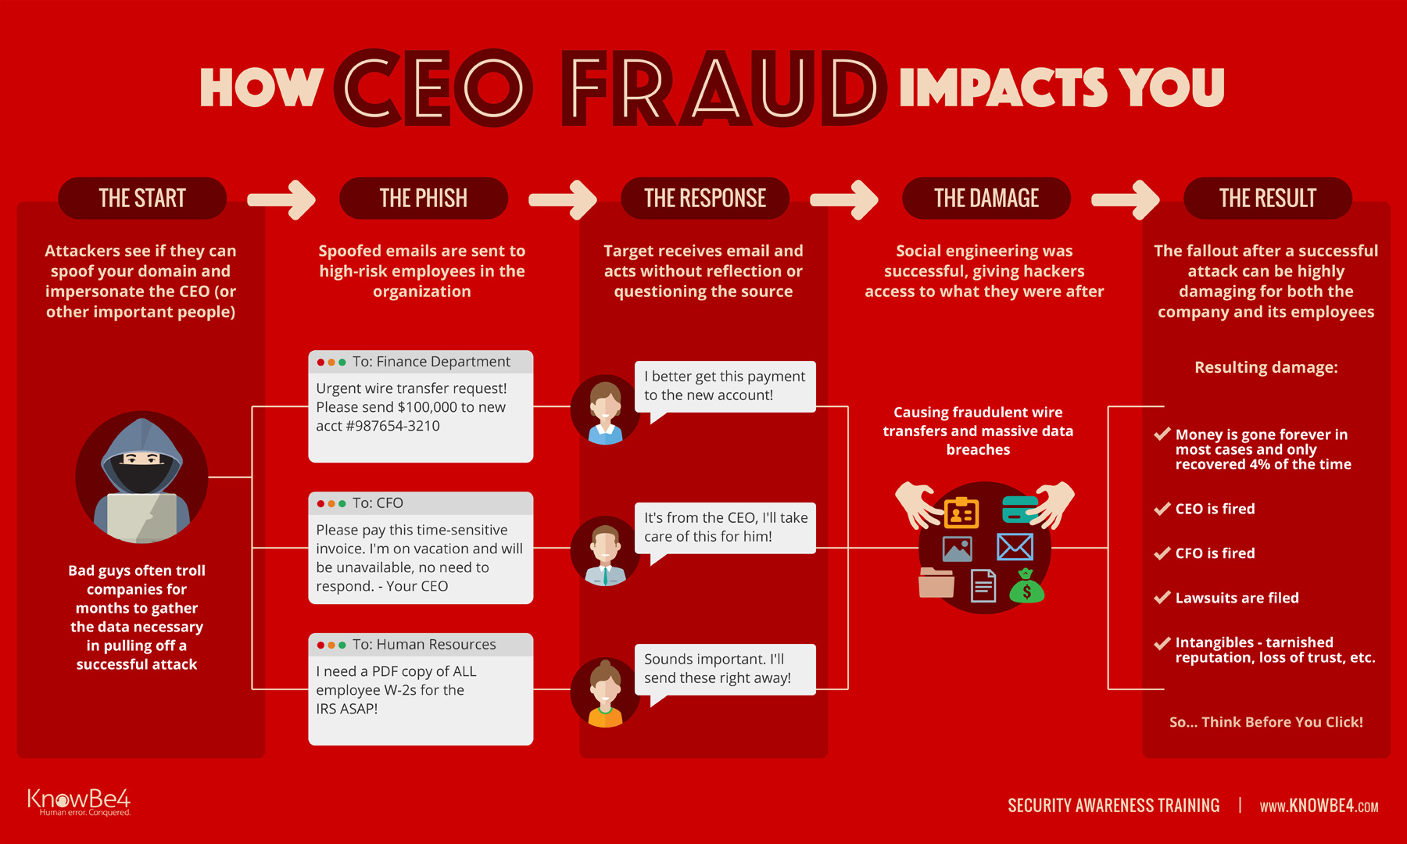
FACC CEO Fraud
2016
54 million euros
Airplane Parts Manufacturer
Fake-president Fraud
CEO and CFO fired, sued
Notes:
https://www.knowbe4.com/ceo-fraud

Slide 6


Robinhood Vishing
November 2021
Called Customer Service
Keys to System
> 5 Million Emails
2 Million Fullnames
310 PII (birthdays, zip codes)
Notes:
https://securityboulevard.com/2021/12/2021-social-engineering-attacks-a-look-back/ https://www.bloomberg.com/news/articles/2021-11-27/when-a-hacker-calls-how-robinhood-fell-victim-to-vishing-attack

Slide 7


Fake Excel File
April 2021
Business Email Compromise (BEC)
Looks like Excel file (.xls file extension)
Actually an HTML file
Fake Office 365 Login Page

Slide 8

HTML Table Windows Logo
April 2021
Email Impersonation
Bypass Email Filters
Catches Images
Allows Tables
Notes:
https://www.scmagazine.com/home/security-news/phishing/scammers-imitate-windows-logo-with-html-tables-to-slip-through-email-gateways/

Slide 9

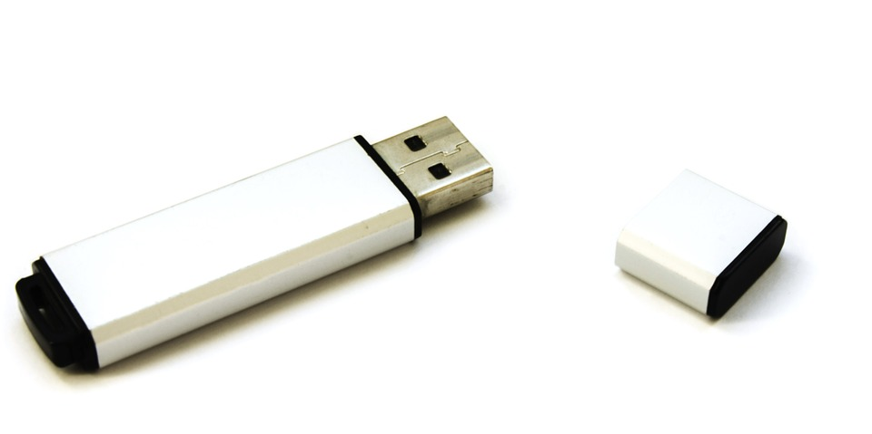
FIN7 USB Mail
August to November 2021
Packages sent via UPS and US Postal Service
Impersonated Department of Health and Human Services and Amazon
USB stick laced with malicious software
Notes:
https://www.cnn.com/2022/01/07/politics/fbi-usb-hackers-warning/index.html

